Slide 1
Analog and Digital Electronic Lab Subject Code:18csl37
Using 741 Opamp, design window comparator for any given UTP and LTP, and simulate the same.

Slide 2
Window Comparator
It detect when the input voltage is between two limits called window.
Use two comparator with different thresholds.
A window comparator is basically the inverting and non-inverting comparators combined into a single comparator stage.
The window comparator detects input voltage levels that are within a specific band or window of voltages. Instead of indicating whether a voltage is greater or less than some preset or fixed voltage reference point.

Slide 3
Window Comparator
This time, instead of having just one reference voltage value, a window comparator will have two reference voltages implemented by a pair of voltage comparators. One which triggers an op-amp comparator on detection of some upper voltage threshold,Vref (upper) and one which triggers an op-amp comparator on detection of a lower voltage threshold level. Vref (lower).
Then the voltage levels between these two upper and lower reference voltages is called the “window”, hence its name.

Slide 4
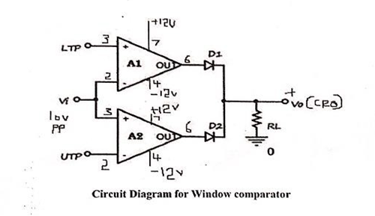

Circuit Diagram for Window comparator
Vi>LTP
Vi<UTP
Vi cross the limit than D1,D2 →Forward biased Vo=1

Slide 5
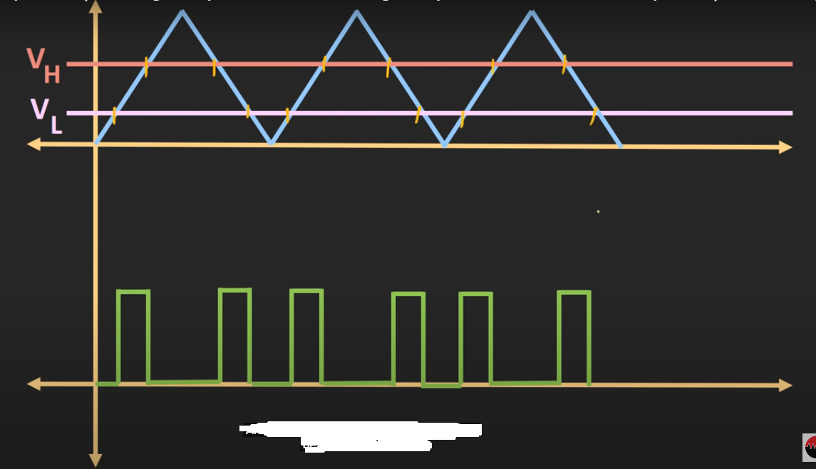
Output waveform

Slide 6
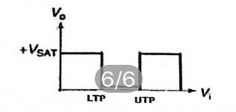
Output waveform

Slide 7
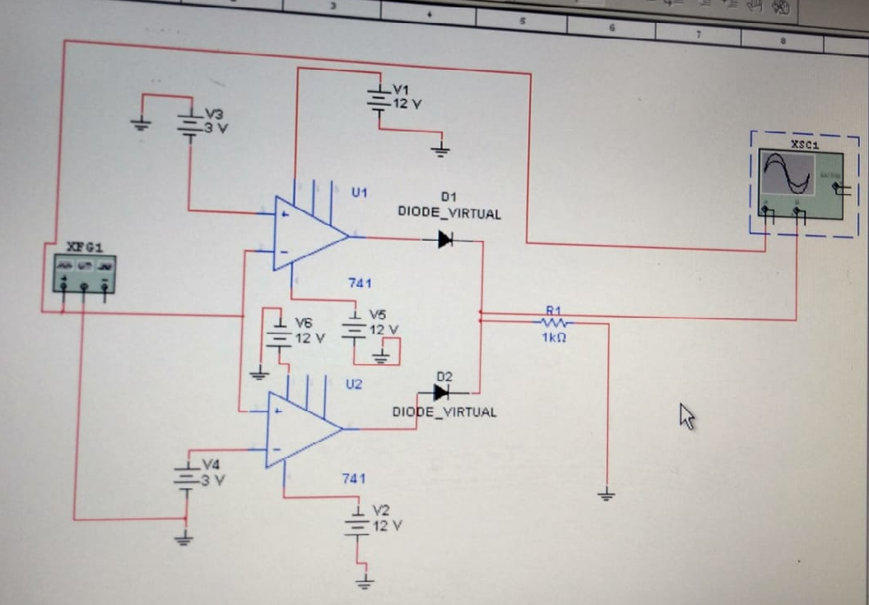
Window Comparator using multisim

Slide 8
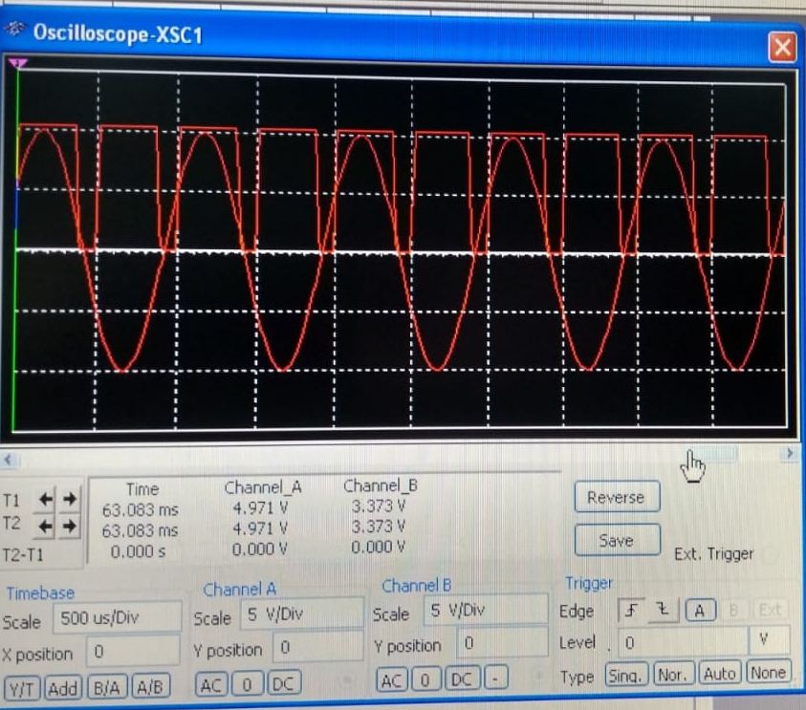
Output waveform for Window Comparator using multisim

Slide 9
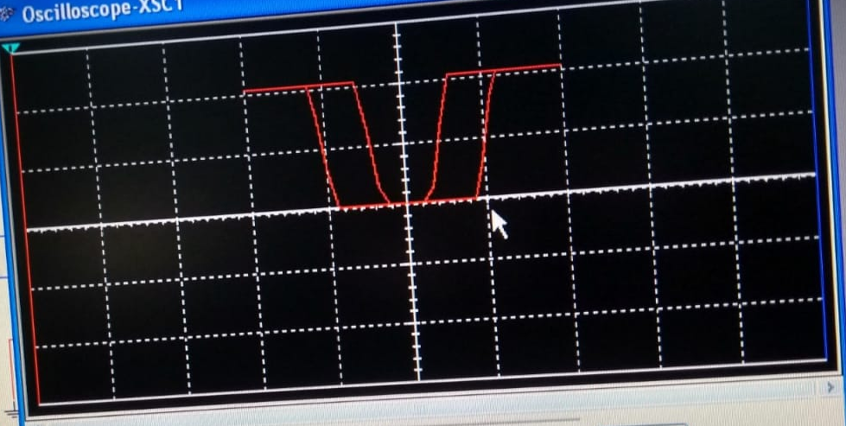
Transfer characteristic for Window Comparator using multisim

Slide 10
Thank you

